Slide 1
ENTREPRENEURSHIP

Slide 2
Entrepreneur
Meaning :
Any person who starts and operates his own business is an entrepreneur.
The word ‘entrepreneur’ originates from the French word ‘entreprende’, which means to undertake.

Slide 3
Concept of Entrepreneurship
An enterprise is created by an entrepreneur.
The process of creation is called “entrepreneurship”

Slide 4
Entrepreneurship
Definition :
Entrepreneurship is a process of actions of an entrepreneur who is a person always in search of something new and exploits it as an opportunity by accepting the risk and uncertainty with the enterprise.

Slide 5
Characteristics of Entrepreneurship
Economic and dynamic activity
Related to innovation
Profit potential
Risk bearing
Decision making

Slide 6
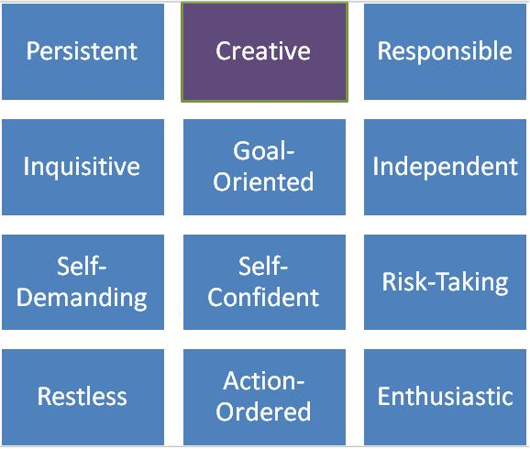
Characteristics of an entrepreneur

Slide 7


Slide 8
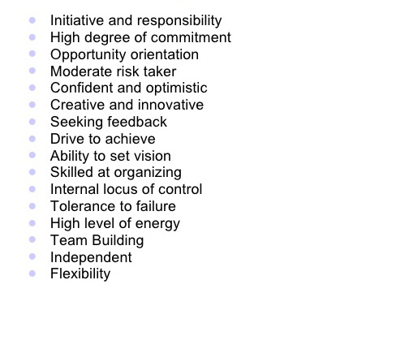

Slide 9
Functions of an entrepreneur
        Idea Generation
        Determination of business objectives
        Product analysis and market research
        Determination of form of ownership
        Innovation
        Completion of promotional formalities
        Assumption of risk
        Raising of funds
        Procurement of machine and materials
        Recruitment of men
        Undertaking of business operations
        Development of management skills
        Overcoming resistance to change
        Catalyst of economic development
Functions
of
an
entrepreneur

Slide 10
Classification of entrepreneur
On the basis of type of business :
  Trading entrepreneur
  Manufacturing entrepreneur
  Agricultural entrepreneur
On the basis of use of technology :
  Technical entrepreneur
  Non - technical entrepreneur

Slide 11
On the basis of ownership :
  Private entrepreneur
  State entrepreneur
  Joint entrepreneur
On the basis of gender :
  Men entrepreneur
  Women entrepreneur
On the basis of size of enterprise :
  Small – scale entrepreneur(<1 crore)
  Medium – scale entrepreneur(1 to 5 crore)
  Large – scale entrepreneur (> 5 crore)

Slide 12
Other types :
  Innovating entrepreneur (Introduces newproduct/methods/market)
  Imitative entrepreneur (Copies successful concepts)
  Fabian entrepreneur (Admits experimentation, change)
  Drone entrepreneur (Do not admit changes)
  Solo entrepreneur (Single owner)
  Active partners (Joint ownership)
  Inventors (Invent new things)
  Buyers (Buy an established business)
  Challengors (Looks for a challenging business)
  Lifetimers (Family business)

Slide 13
Intrapreneur
Intrapreneurs are usually employees within a company who are assigned to work on a special idea or project, and they are instructed to develop the project like an entrepreneur would

Slide 14
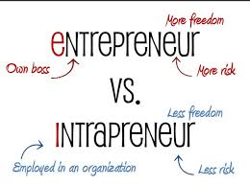

Slide 15


Slide 16
BASIS FOR COMPARISON | ENTREPRENEUR | INTRAPRENEUR
Meaning | Entrepreneur refers to a person who set up his own business with a new idea or concept. | Intrapreneur refers to an employee of the organization who is in charge of undertaking innovations in product, service, process etc.
Approach | Intuitive | Restorative
Resources | Uses own resources. | Use resources provided by the company.
Capital | Raised by him. | Financed by the company.
Enterprise | Newly established | An existing one
Dependency | Dependent | Independent
Risk | Borne by the entrepreneur himself. | Taken by the company.
Works for | Creating a leading position in the market. | Change and renew the existing organizational system and culture.

Slide 17
Role of entrepreneurship in economic development
Promotes Capital Formation
Creates Large-Scale Employment Opportunities
Promotes Balanced Regional Development
Reduces Concentration of Economic Power
Wealth Creation and Distribution
Increasing Gross National Product and Per
Capita Income
Improvement in the Standard of Living
Promotes Country's Export Trade
Induces Backward and Forward Linkages
Facilitates Overall Development

